Slide 1
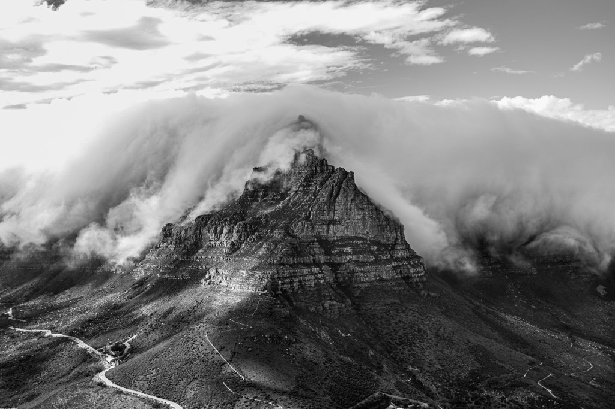
Adventure Escape SA
Website and mobile development
Zusange MBALEKI and Chantell libisi

Slide 2

Why we chose this design
Reflects outdoor adventure and eco-tourism.
Uses a nature-inspired visual style.
Keeps the website and app user-friendly.

Slide 3

Strategies for growth
Green - #14532D
Blue - #0077B6
Orange - #D97706
White - #FFFFFF
Charcoal - #1F2933

Slide 4
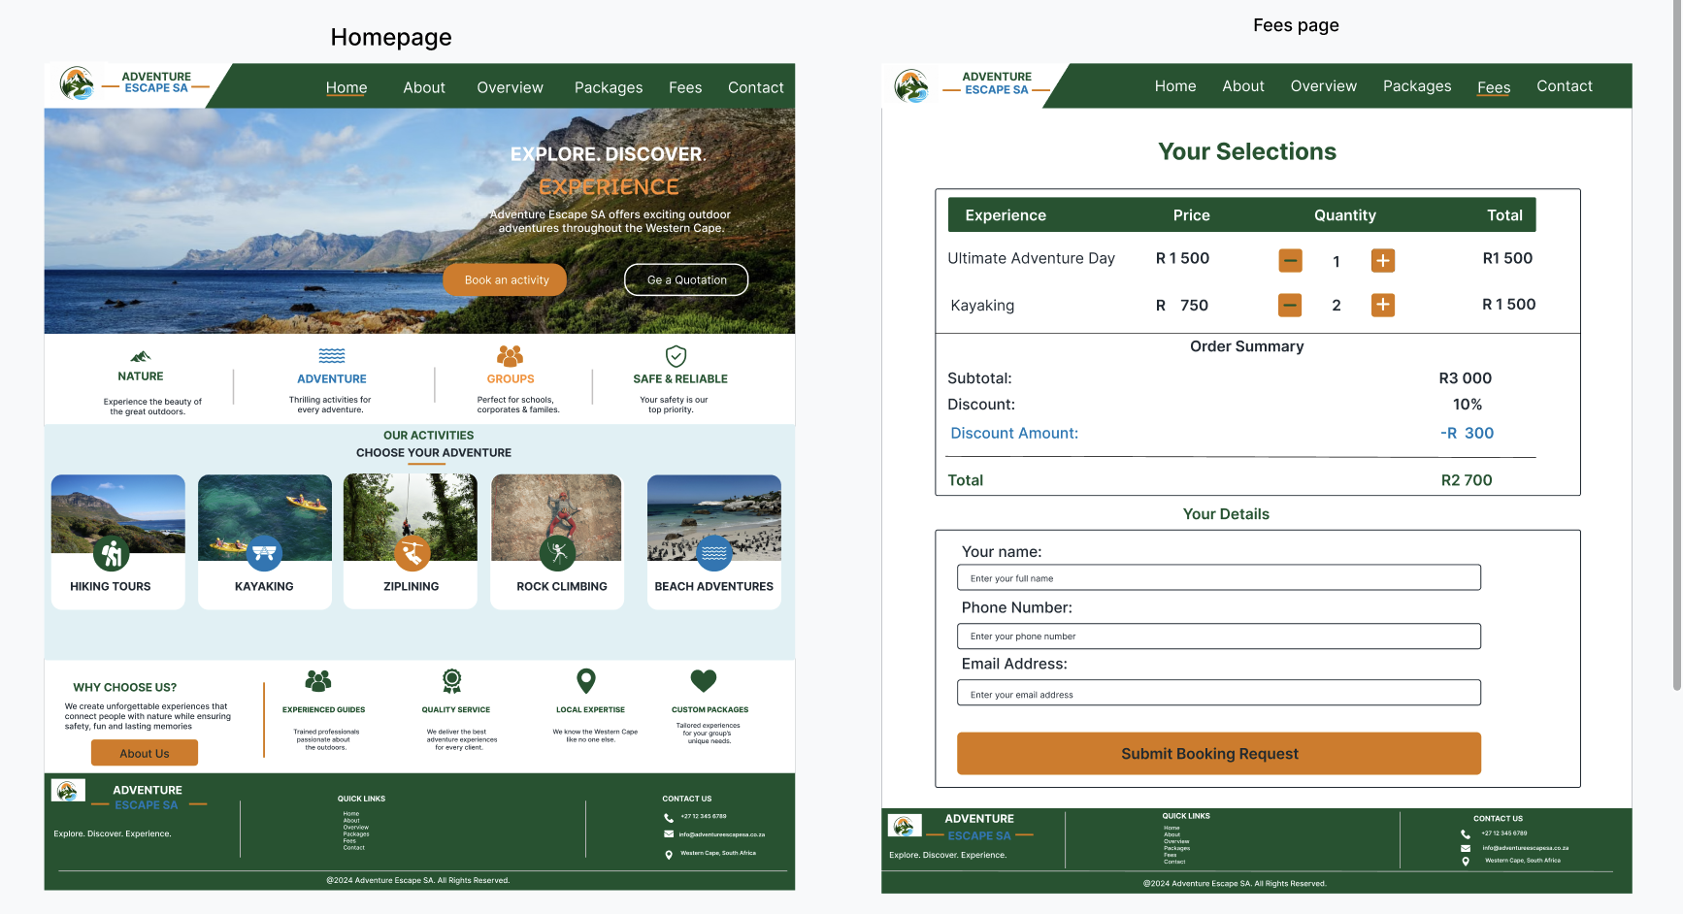
Website Wireframes
Home and Fees pages.

Slide 5
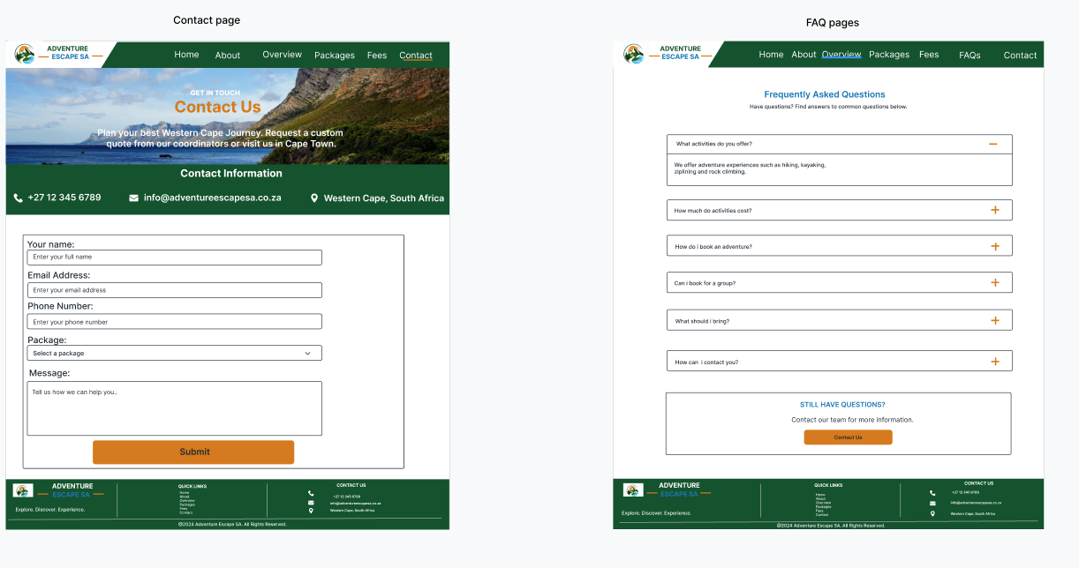
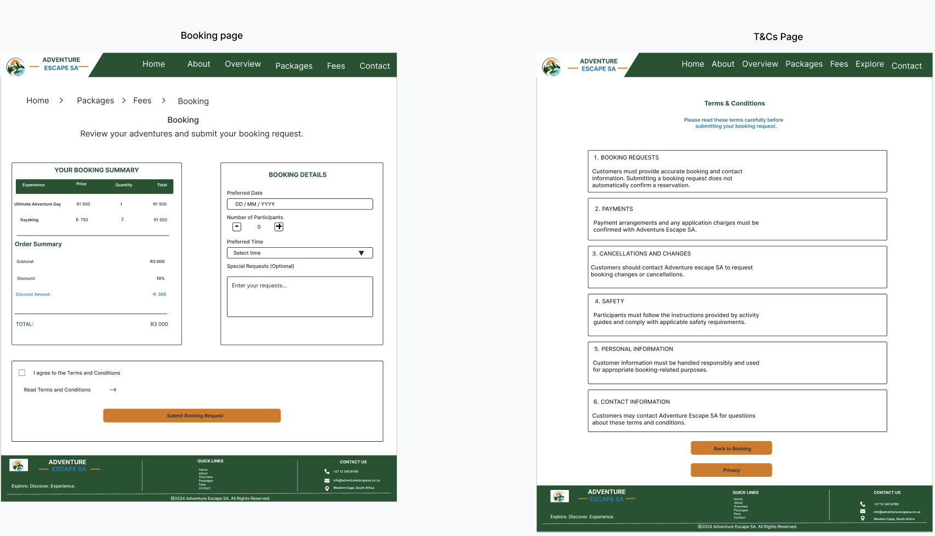
Booking and T&Cs Pages
Contact page and FAQs page

Slide 6
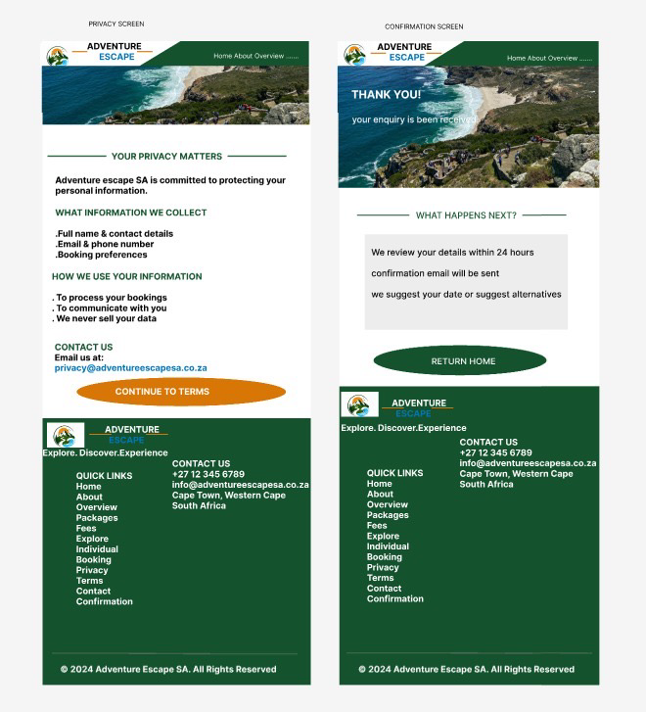
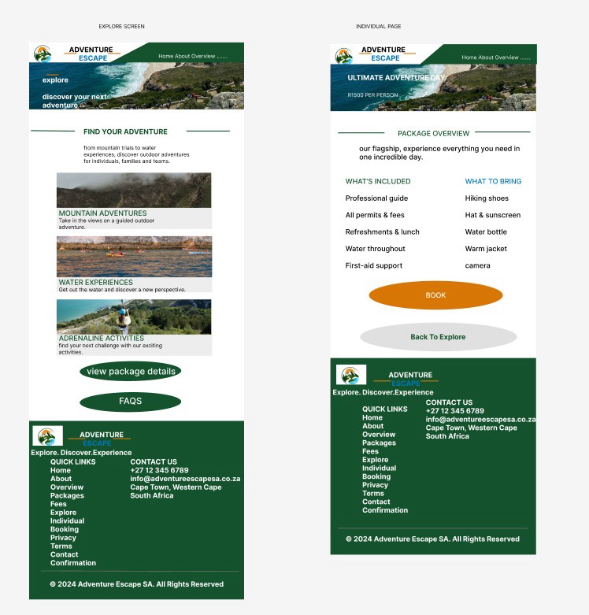
Explore and Individual Pages
Privacy and Confirmation Page

Slide 7
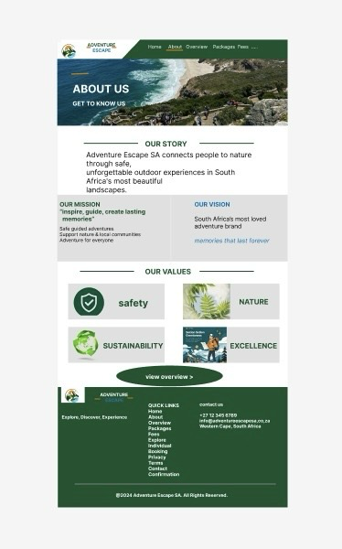
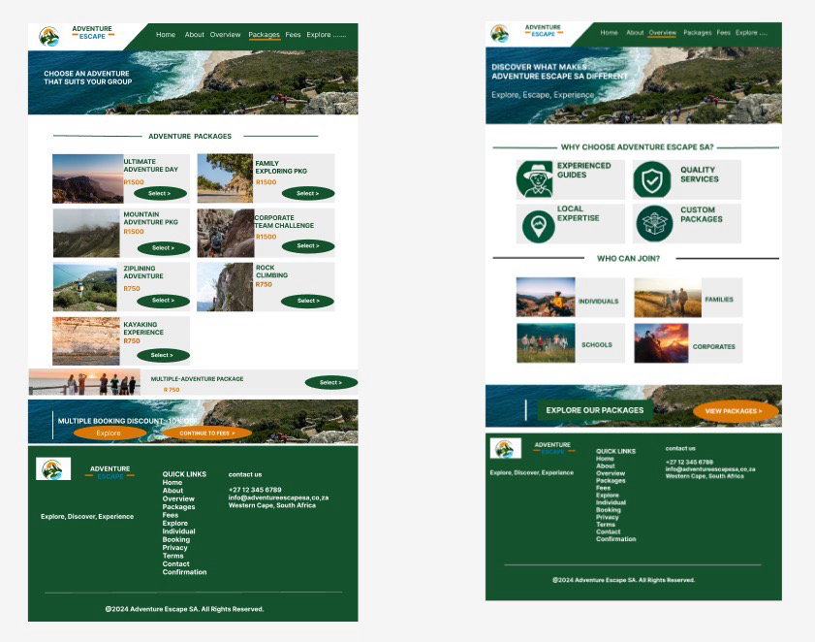
Packages and Overview Pages
About Page

Slide 8
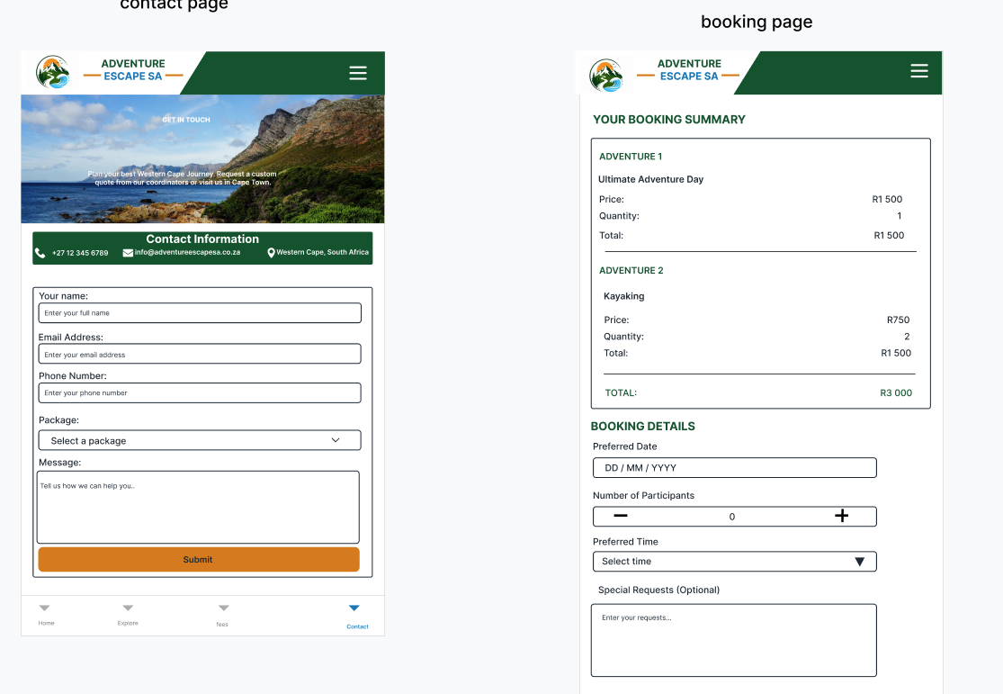
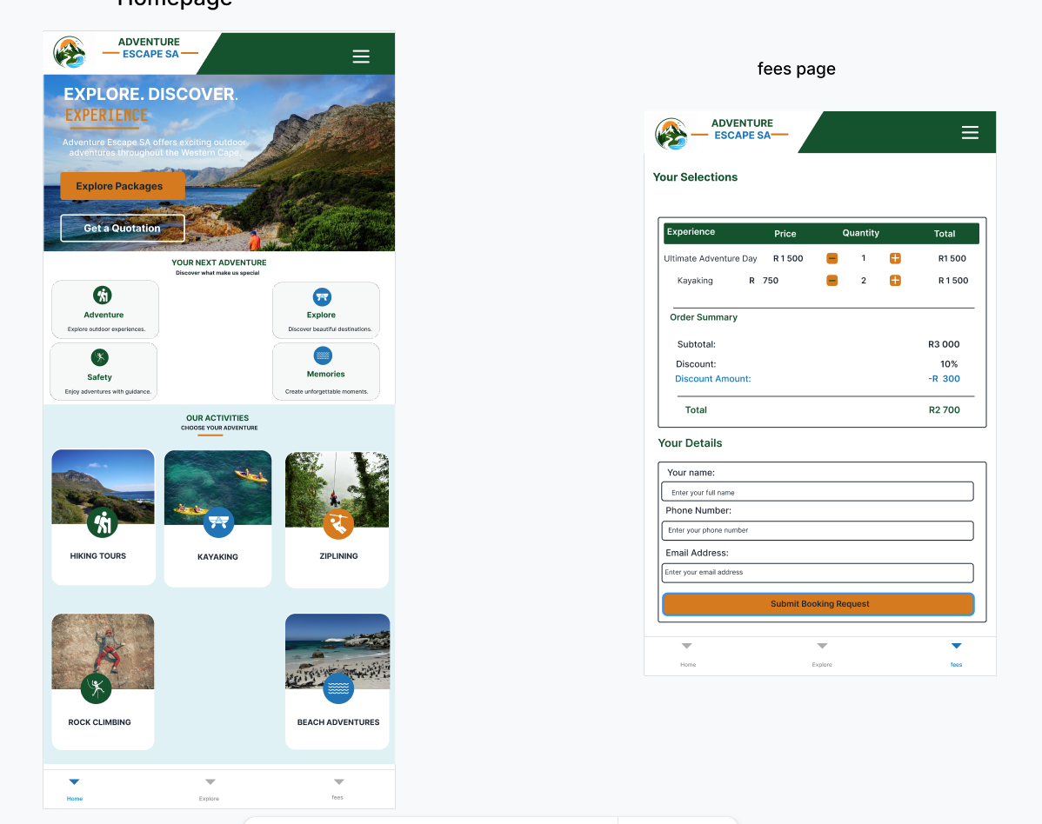
Mobile application Wireframes
Contact page and booking page
Homepage and fees page

Slide 9
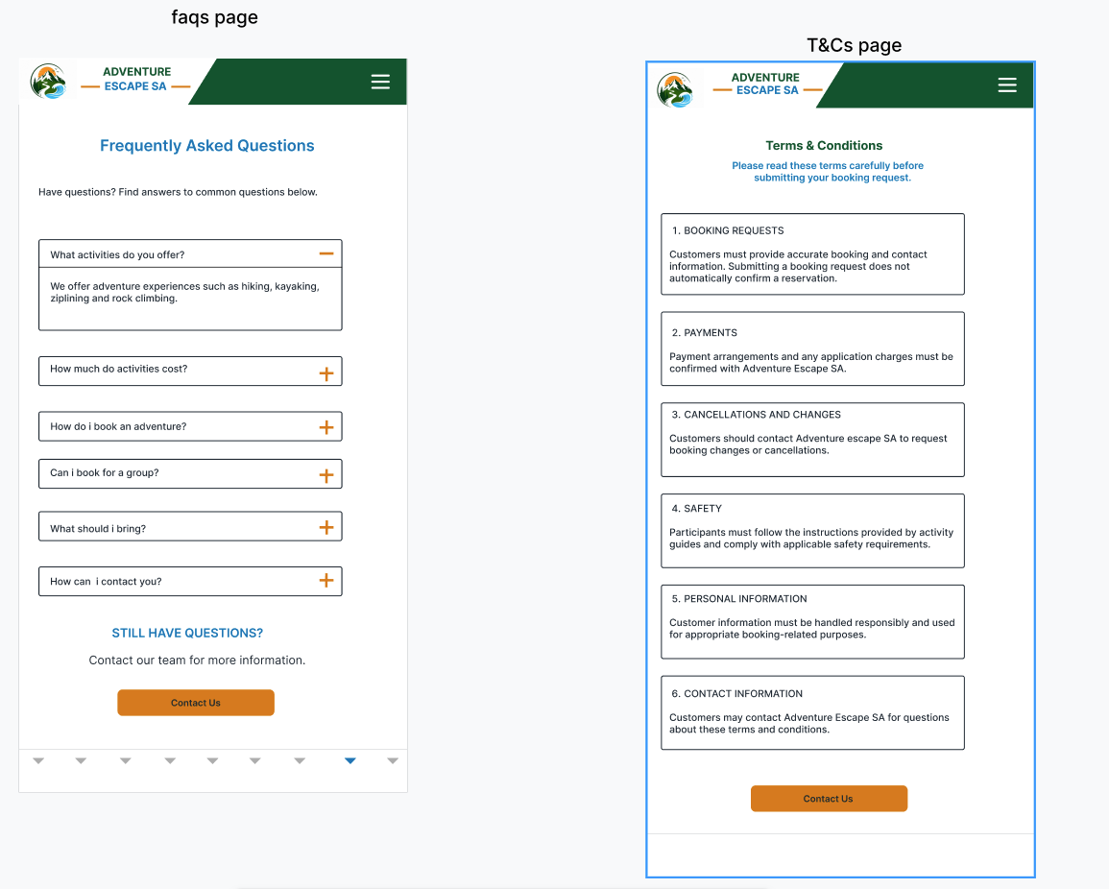
FAQs and T&Cs Pages

Slide 10
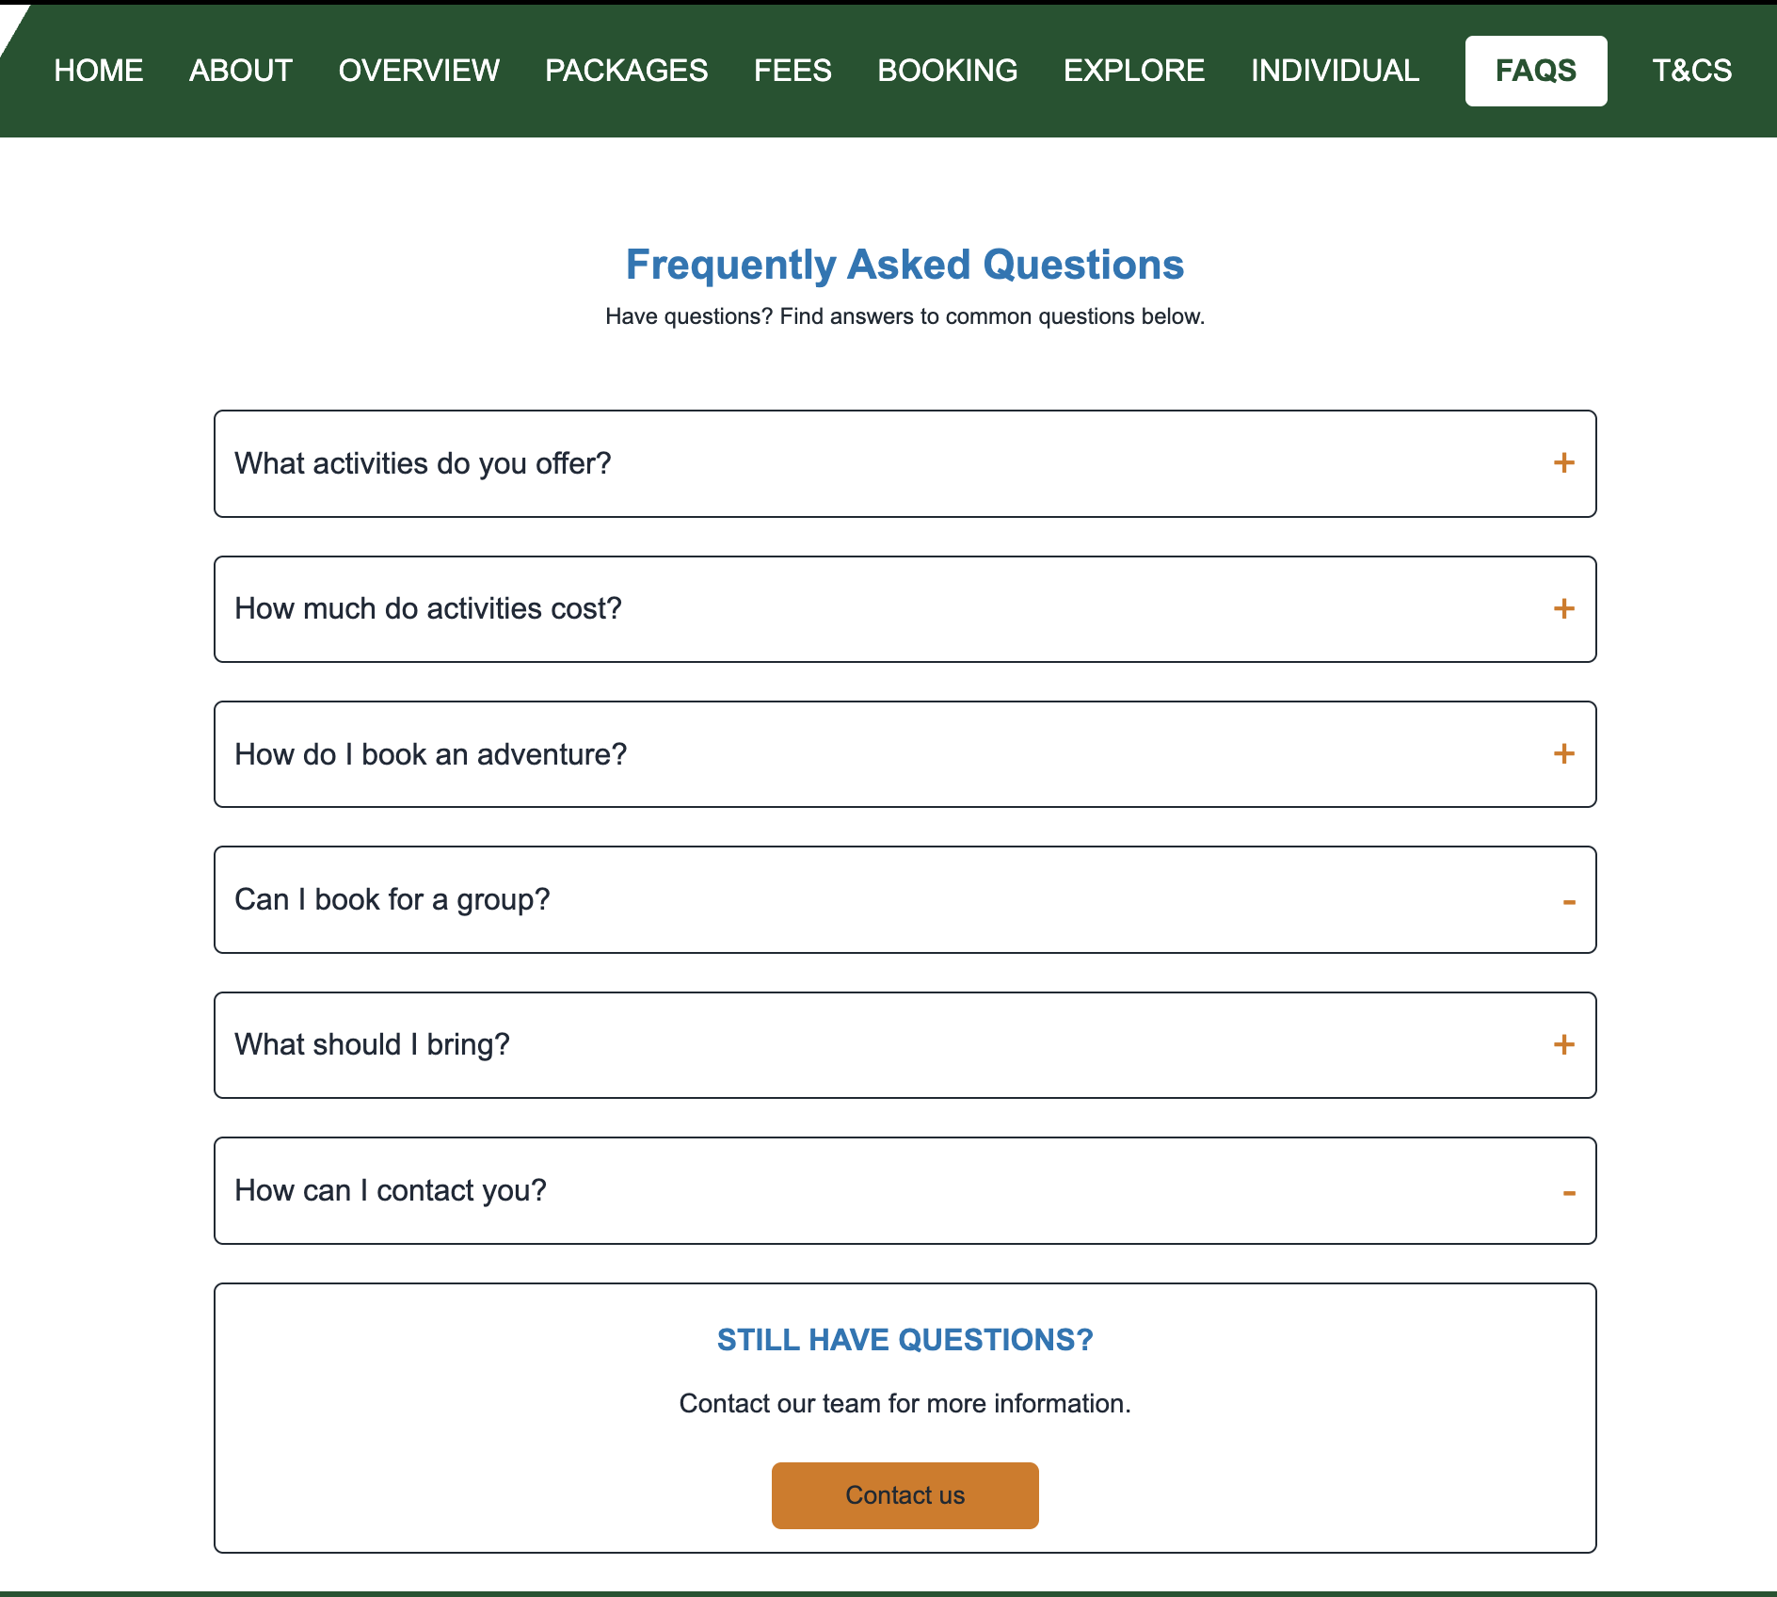
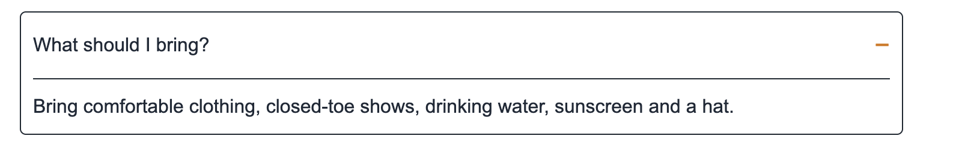
FAQ Accordion Functionality
Screenshot showing FAQ questions
Screenshot showing an expanded question with its answer

Slide 11
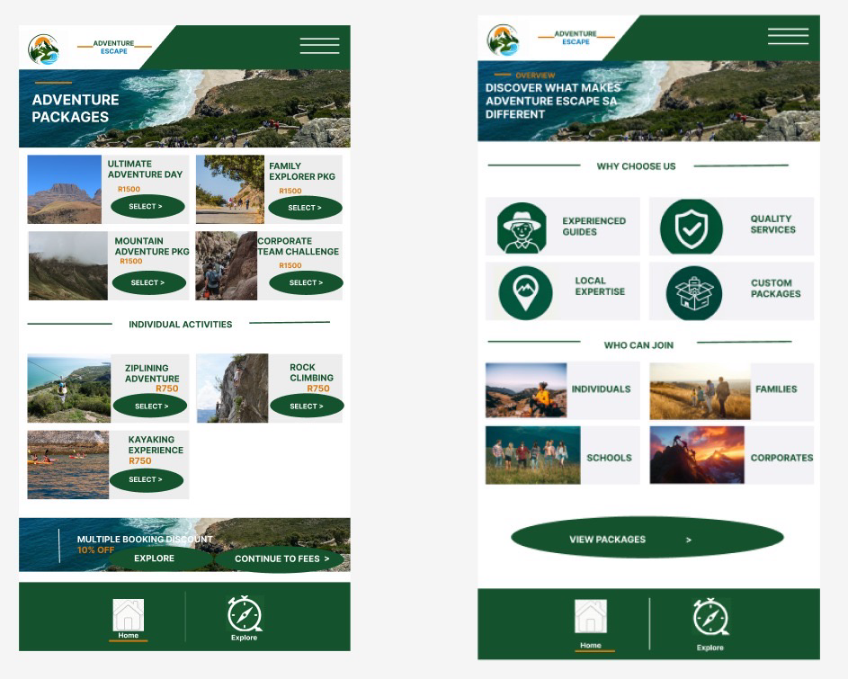
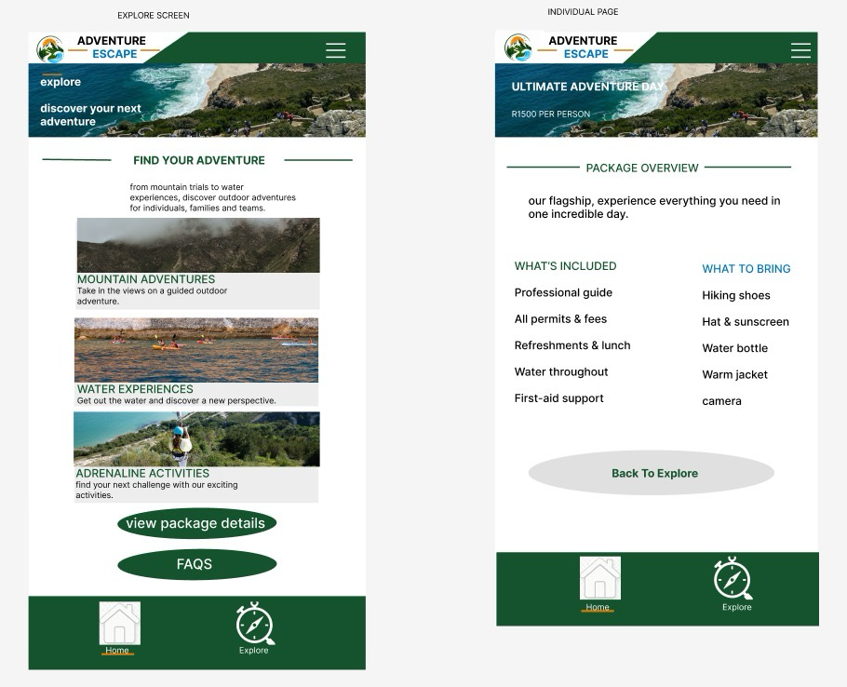
Explore and Individual pages
Packages and Overview pages

Slide 12
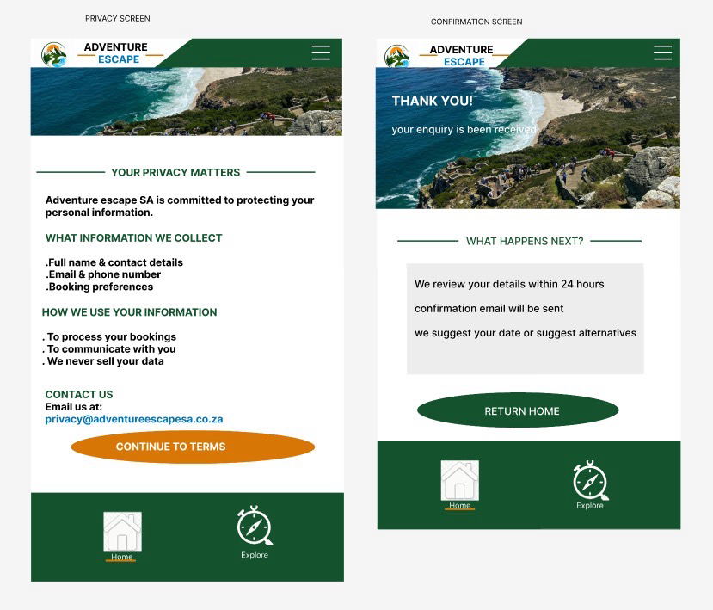
Privacy and Confirmation Pages

Slide 13
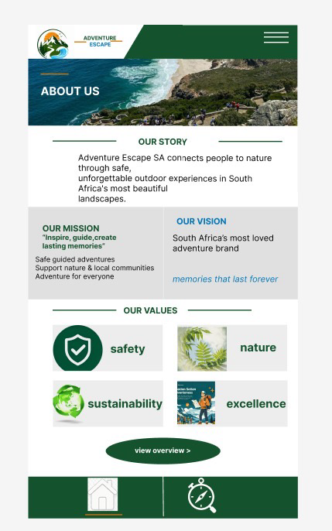
About Page

Slide 14
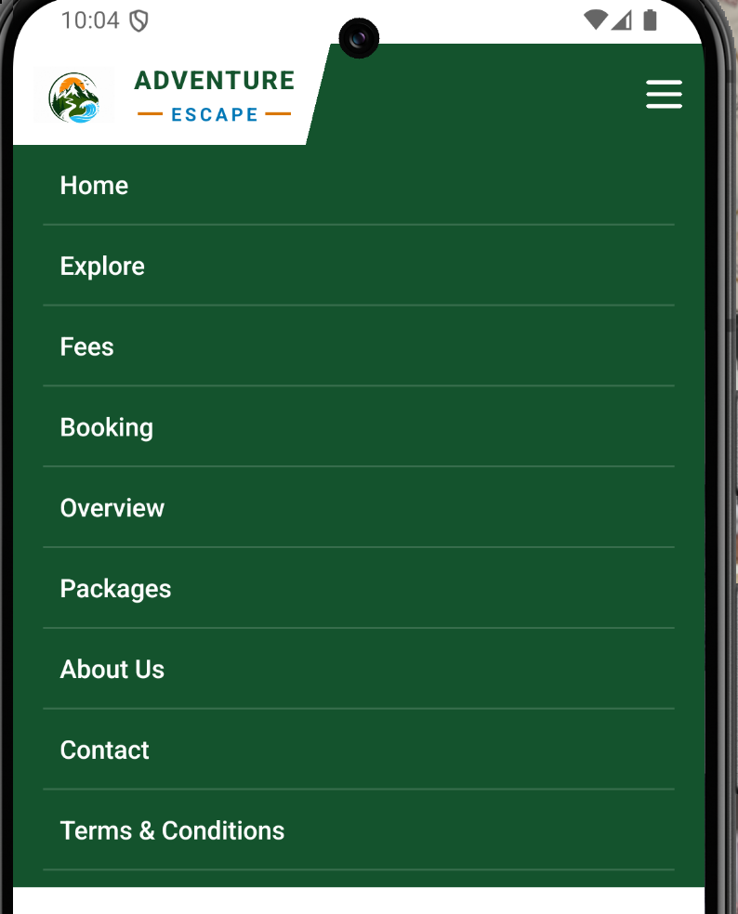
Navigation Menu Functionality
Mobile app navigation dropdown menu screenshot
Website navigation bar screenshot

Slide 15

Live demonstration
Mobile application Live demonstration demonstration
Website Live demonstration: https://sangem6.github.io/Adventure_Escape_SA

Slide 16
Thank you

